Slide 1


AGE 316:
MICROCOMPUTER SYSTEMS
LECTURE 2: HARDWARE & ARCHITECTURE
Dr. Kadeghe Fue
Department of Agricultural Engineering

Slide 2

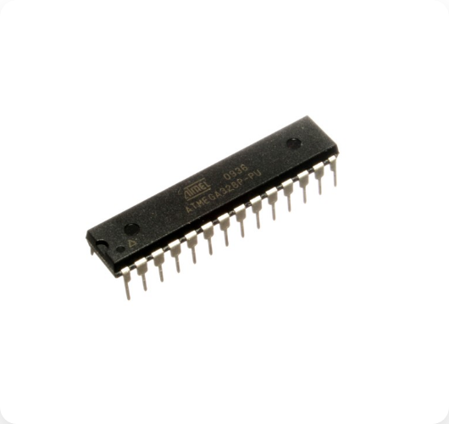
Recap: The Brain of the Operation
Recall from Lecture 1: The Microcontroller is a Computer on a Chip.
ATmega328P
Manufacturer: Atmel (Microchip)
Architecture: AVR 8-bit RISC
Speed: 16 MHz Clock
"This small chip handles all the logic, sensing, and control for your projects."

Slide 3

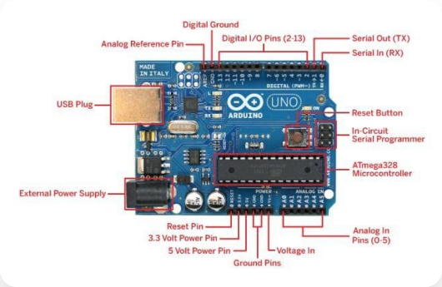





Dissecting the Arduino Uno
USB Port: Power & Code upload.
DC Power Jack: External power (7-12V).
Digital Pins: On/Off signals & PWM.
Analog Pins: Reading sensors.
Reset Button: Restart program.

Slide 4


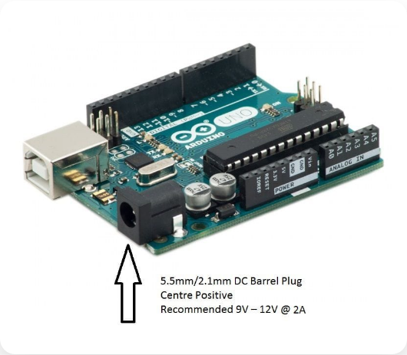


Power Supply: The Lifeblood
Option A: USB Cable
Supplies regulated 5V. Best for programming and low-power sensors.
Option B: DC Barrel Jack
Input: 7V - 12V. Best for standalone projects (batteries/wall adapter). Onboard regulator steps it down.
WARNING:
Do not supply >12V or reverse polarity! You will fry the voltage regulator.

Slide 5







Input / Output (I/O) Pins
Digital I/O
Analog Input
Power Pins
Pins 0 - 13
Pins A0 - A5
Power Header
States: HIGH (5V) or LOW (0V).
Function: Reads voltage (0-5V).
•
5V: Regulated output
Special: PWM (~) on pins 3,5,6,9,10,11 for simulated analog output.
Conversion: 10-bit ADC converts voltage to integer (0 - 1023).
•
3.3V: For low voltage sensors
•
GND: Ground (0V)

Slide 6
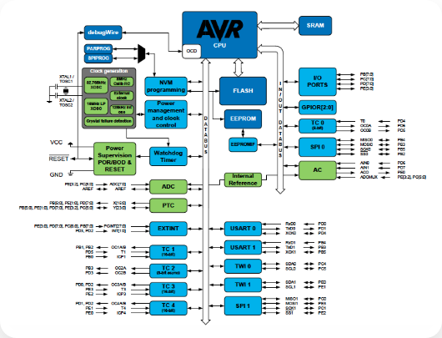



Memory: Inside the Chip
Just like a laptop, the microcontroller has different types of memory for different jobs.
Your Sketch (Code) lives here. Non-volatile (saved when power off).
Variables & Calculations. Volatile (lost when power off).
Long-term storage settings. Non-volatile.

Slide 7

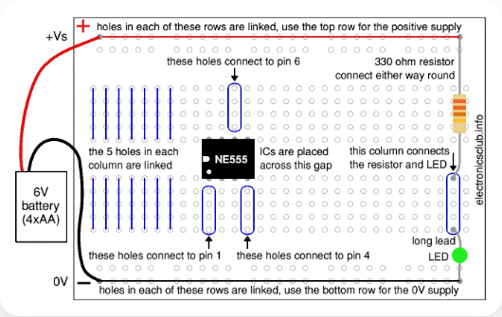
The Breadboard: Circuit Sandbox
How it connects:
Terminal Strips:
Connected Horizontally (rows of 5 holes). Used for components.
Power Rails:
Connected Vertically (+ and -). Used to distribute power.
Tip:

Slide 8



Summary & Next Steps
Today's Key Concepts
Next Lecture: Software!
ATmega328P is the brain.
We will open the Arduino IDE and write our first line of code.
Power via USB (5V) or Jack (7-12V).
Digital vs Analog pins.
Flash stores code, SRAM runs it.
Bring your laptops!

Slide 9


Questions?
"The only stupid question is the one you don't ask."
Dr. Kadeghe Fue
Sokoine University of Agriculture

Slide 10






Image Sources
https://electropeak.com/media/catalog/product/cache/a99a51fafac039a73087ecfaa8ccceba/s/2/s2-0004.jpg
Source: electropeak.com
https://storage.googleapis.com/filo-question-diagrams/6979428_yjapyR_1757351792319062270_image_crop_297ef571-ec6e-4f32-9784-15cbb278a9cc3690835564718814858.jpg
Source: askfilo.com
https://cdn.shopify.com/s/files/1/0176/3274/files/6_61891bb2-0a39-4281-bf1c-04094b205242_1024x1024.jpg?v=1561718127
Source: thepihut.com
https://www.arnabkumardas.com/blog/wp-content/uploads/2021/04/avrbus.png.webp
Source: www.arnabkumardas.com
https://electronicsclub.info/images/breadboardlinks.gif
Source: electronicsclub.info

